Slide 1





PlantCLEF2025 @ LifeCLEF & CVPR-FGVC
Multi-label Plant Species Prediction from Quadrat Images
Team NEXORA
M. I. NADHA 220409J
M. M. M. MUFTEE 220399B

Slide 2
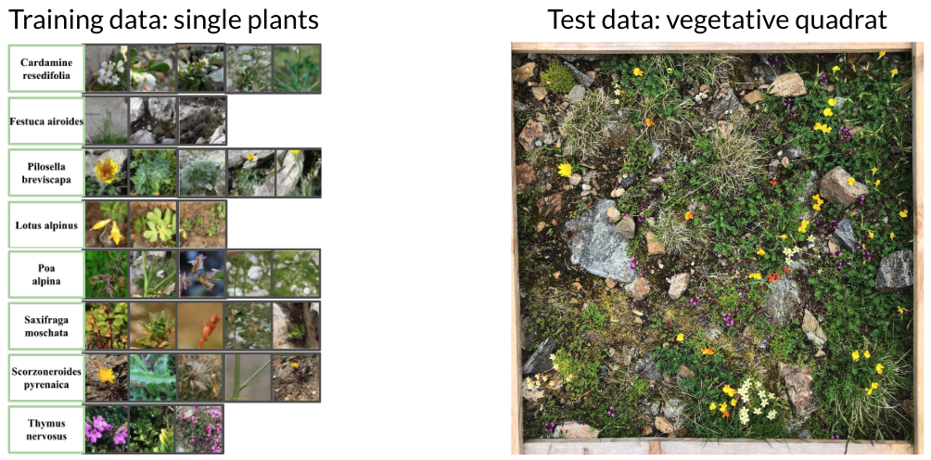
Multi-label Plant Species Prediction from Quadrat Images
Training Data:
1.4 million single species images covering 8.4k plant species
Test Data:
2105 vegetation quadrat images
Problem Statement
The domain-shift between single-label training images and multi-label test images

Slide 3
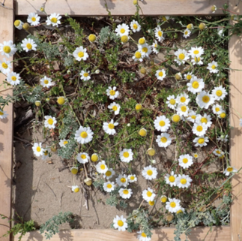
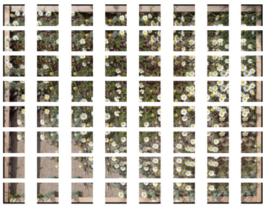
Approach
Quadrat Image ⟶ Pytorch tensor
Binary Classifier
(Plant vs non plant artifacts)
PreProcessing
DINOv2+MLP classifier
Quadrat level species
Tile aggregation and thresholding
Split into tiles

Slide 4
Model Architecture
Input image (518x518)
Patch Embeddiing
Positional Encoding
x12 Transformer Blocks
Layer Norm
MLP Classiification head

Slide 5
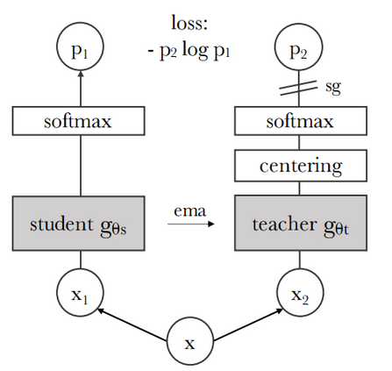
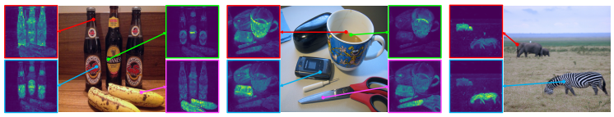
Backbone: DINOv2 ViT
DINO = Distillation with No Labels
It's a self-supervised learning method:
Train a vision model without labels.
The model learns useful representations by comparing different views (augmentations) of the same image.
Process:
Breaks the image into patches.
Uses Transformer attention layers to combine patch information.
Outputs a feature embedding vector (e.g., 768 or 1024 dimensions).
Input: plant image (quadrat tile).
Output: a compact representation of the plant image that captures shapes, textures, and patterns.
That embedding is then passed to a classifier head

Slide 6
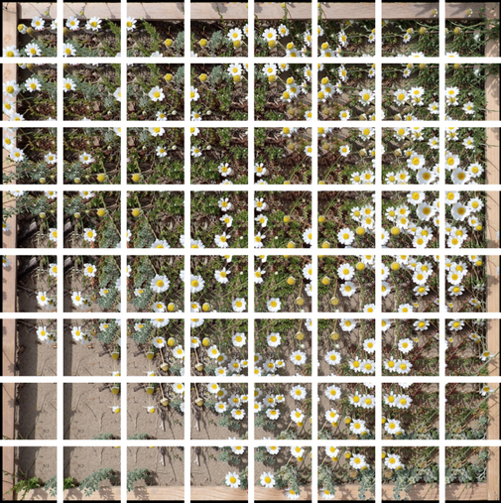

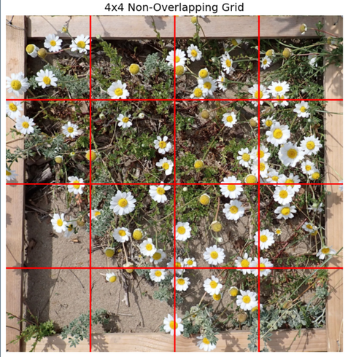
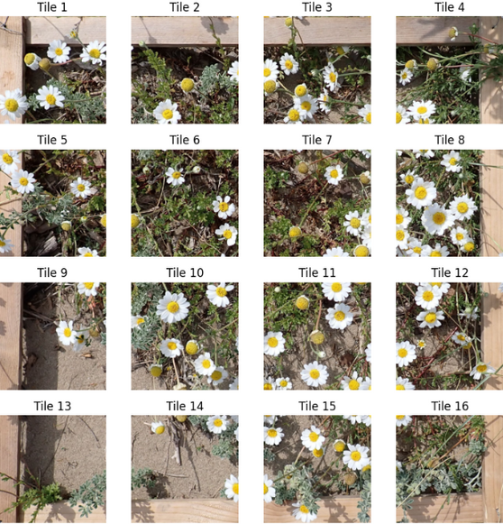
Tiled Inference
Sliding Window Tiling (Overlapping)
2. Fixed Grid Tiling (Non overlapping)

Slide 7
Binary Classifier
To reduce false positives caused by the non plant regions, a binary classifier will be employed to distinguish plant vs. non-plant regions.
Dataset: A separate collection of non-plant images will be used alongside plant tiles.
Methods to be tested:
Logistic Regression
Random Forest
ViT-based classifier
Quadrat Image ⟶ Pytorch tensor
PreProcessing
Binary Classifier
(Plant vs non plant artifacts)
DINOv2+MLP classifier
Quadrat level species
Tile aggregation and thresholding
Split into tiles ⟶ Sliding window approach

Slide 8
Top k predictions with softmax
Model output logits
Top K classes
Softmax
Probabilities
Minimum score
Species predicted
Softmax
Logit averaging
Model output logits
Average per species
Weighted Logit averaging
Maximum softmax probability
x Model output logits

Slide 9
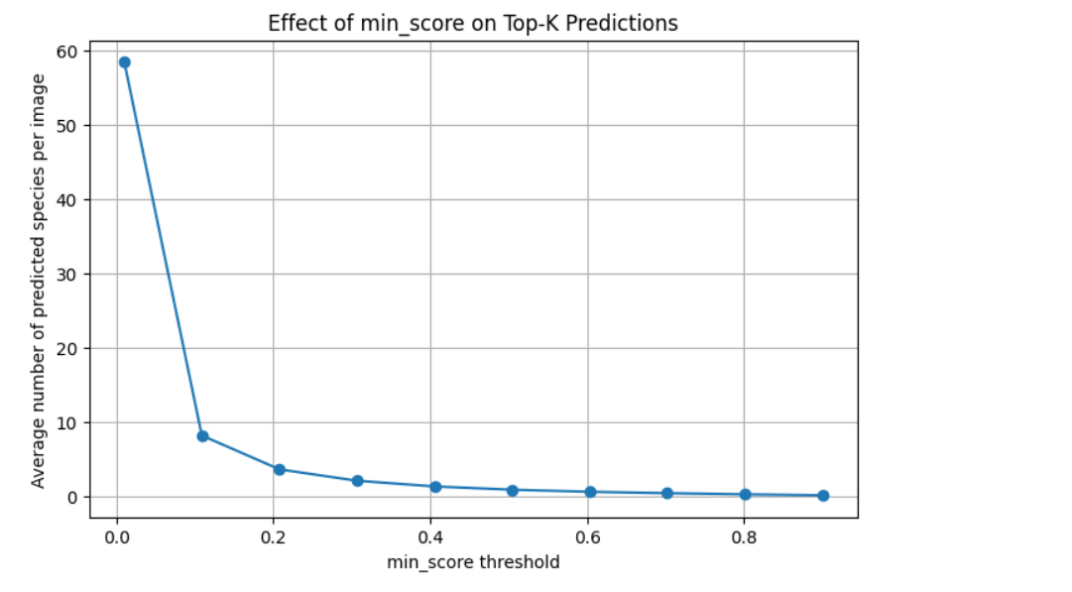
Minimum score vs the average number of predicted species per image

Slide 10
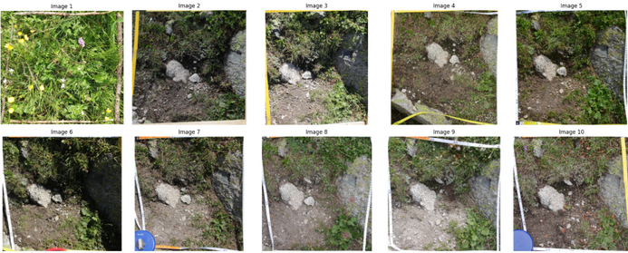
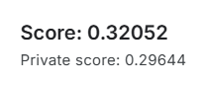
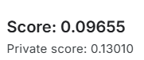
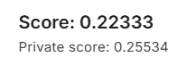
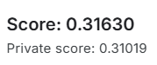
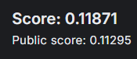
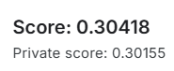
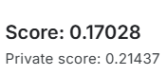
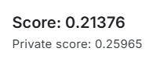
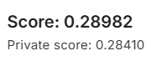
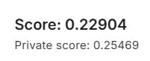
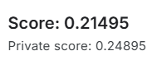
Prediction Scores
DINOv2+MLP classifier
Top K prediction with softmax
Weighted Logit Averaging
Logit Averaging
Min score
Min score
Min score
Min score
0.3
0.2
0.01
0.3
0.5
0.05
0.05
0.5
0.7
0.01

